Slide 1
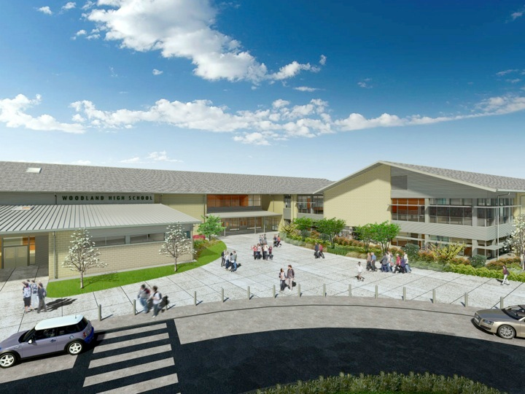
Woodland Public Schools
Facilities and Safety Report
March/April 2019

Slide 2
FACILITIES REPORT
Portable 4-5
All stored items have been remove, both restrooms have been built and covered with sheetrock. Rough-in plumbing and electrical are complete. Expect final plumbing and electrical to be complete the week of May 27th. We are completing wall repairs this week, and expect to paint out the rooms, also on the week of the May 27th. Carpet and vinyl are about two weeks out.
Portable 6-7
This portable will not require near the work that 4-5 needed. VCT flooring will need to be replaced, a new aluminum ramp, some minor window and ceiling repairs are needed. Unfortunately, we will not be able to work this building until LCC finishes classes on June 13th . That will essentially start the ball rolling for the portable buildings.
Fencing Modifications (WPS)
As we move students out to the portable buildings, this changes our security boundary at WPS (CES). Gates (both vehicle and pedestrian), will have to be modified/added, to include the portable buildings within the secured envelop of the school.
This work will be completed during the summer period.

Slide 3
FACILITIES REPORT
Gas Shut-Off WMS 5/24 -We will be installing a seismic gas shutoff valve for the Middle School complex. This valve is also being fitted with a solenoid valve that will allow remote shutdown capabilities. This modification will allow a natural gas detection system to be connected to the valve. This will shut off the gas supply to the building, in the event of a leak, before it comes to a combustible level. The detection system will also be tied into the building evacuation/alarm system, so students and staff can evacuate, in the case of a natural gas leak.
Office Approach Cameras
We are waiting for the receipt and installation of a Chrome stick to start up the first of five dedicated entry camera/monitor systems, visible 100% of the time to the school office staff. These cameras will allow office staff to quickly ascertain entryway behavior.
LCC Relocate
As part of the school realignment, LCC will be moving to the LRA area of the Middle School. This will accommodate Community Outreach’s move to portable 8/9, and subsequent movement of WPS Preschool to Portable 6/7.

Slide 4
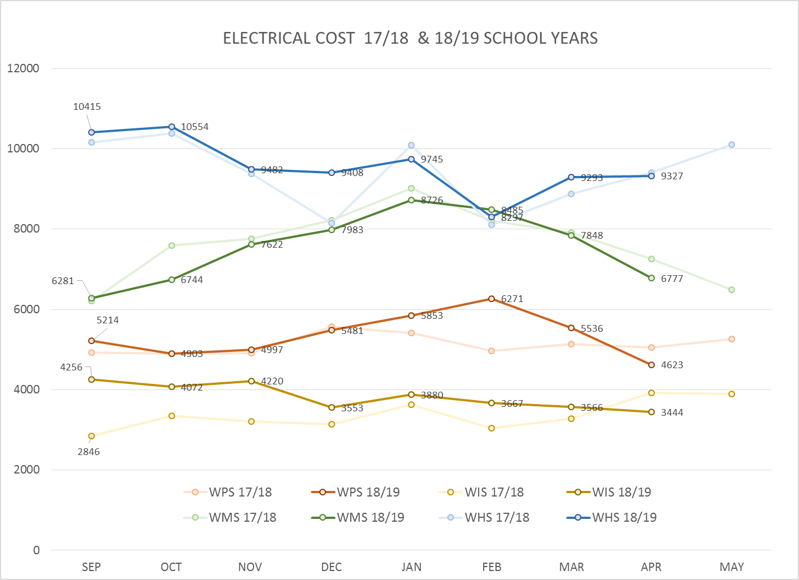
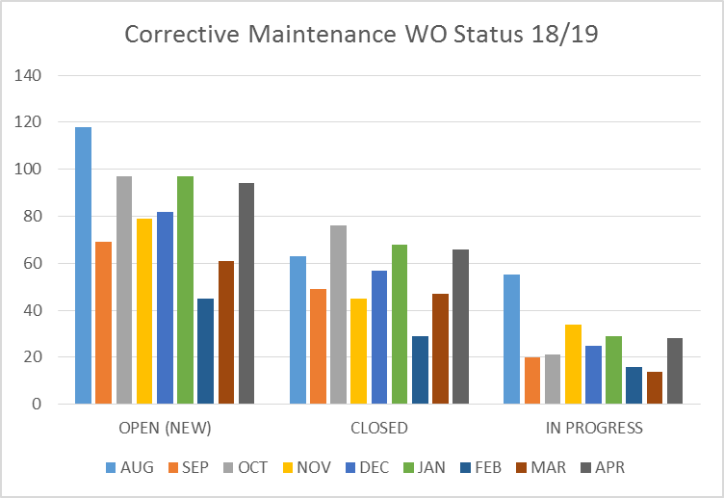
FACILITY CHARTS – POWER COST AND WORK ORDER STATUS

Slide 5
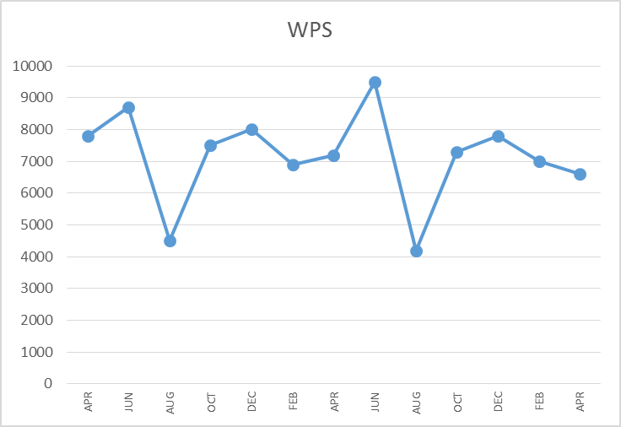
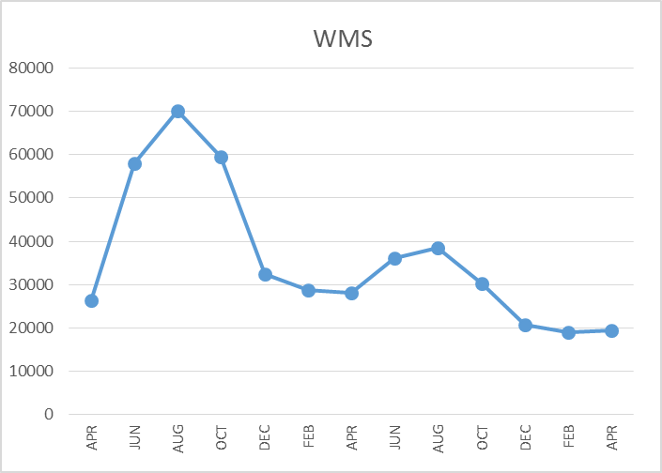
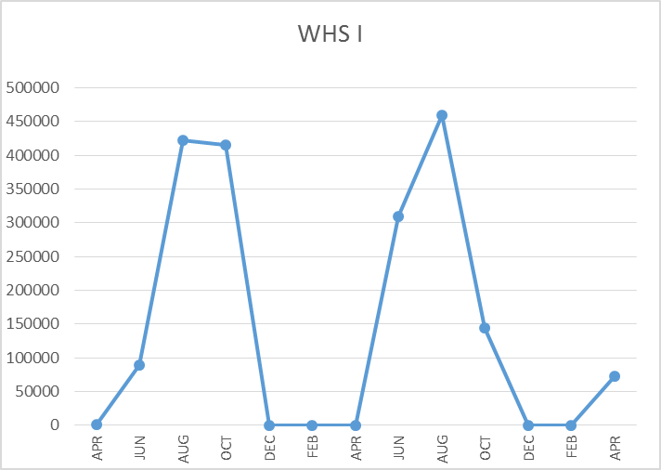
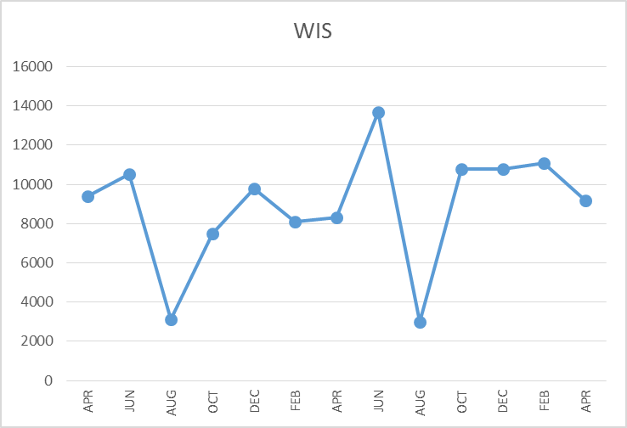
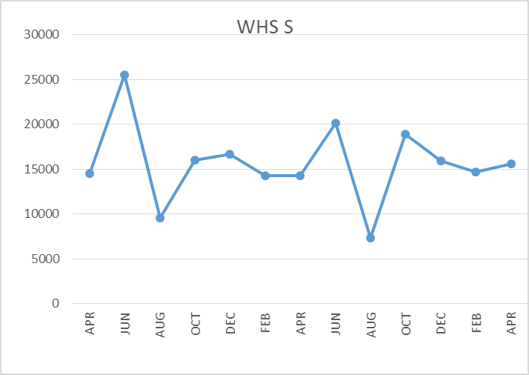
FACILITY CHARTS –
WATER USAGE
WHS, WIS, WMS, WPS
Note
Water charts are updated every two
months. Next update to these charts
in July 2019.
The WMS chart has been reconfigured to include the following 7 meters: 755 Park high and low flow, BO and Team High, PIT house, bus barn, athletic field and DO. All of these meters are totaled on the WMS graph, but each data point is recorded separately to aid in identifying leaks.

Slide 6
SAFETY DATA
Accidents for the Month
There were 9 accidents/incidents for the month; 5 staff and 4 students.
Staff Accidents/Incidents
WMS – Maintenance worker hit head on beam while working in attic, lost balance.
WMS- Grounds worker lacerated finger when moving piece of sheet metal.
WPS - Employee tripped on stand, injured neck.
WHS - Staff member cut finger while working on classroom equipment.
Yale - Employee sprained ankle and back running to playground during parent escalation.
Student Accidents/Injuries
WHS - Student sprained right ankle during soccer.
WHS – Student’s foot was run over by wheelchair, minor bruising.
Yale - Student became dizzy during warm ups; fell and hit head on floor.
Yale - Student ran into monkey bars while not paying attention; minor head injury.

Slide 7
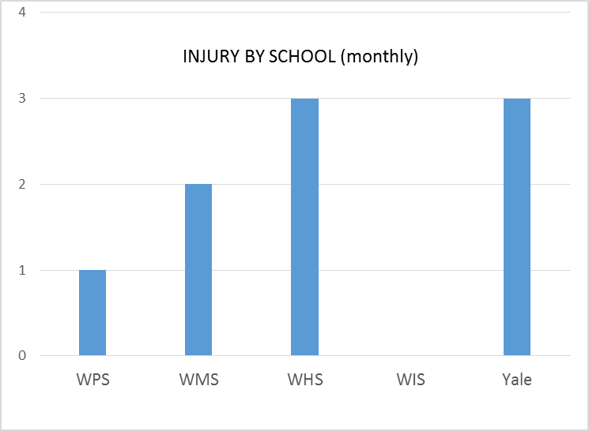
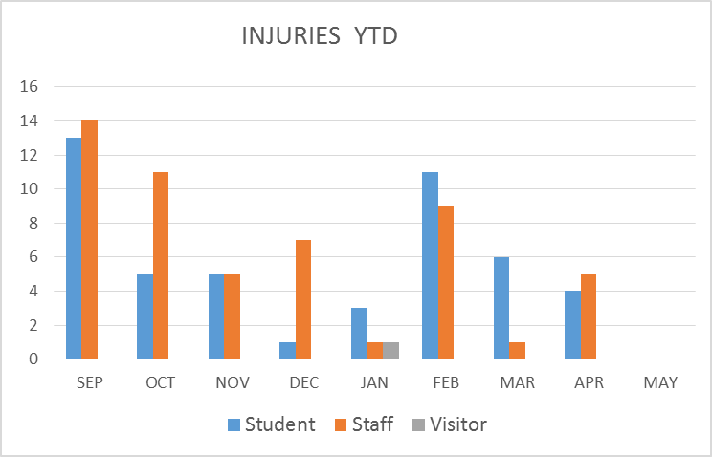
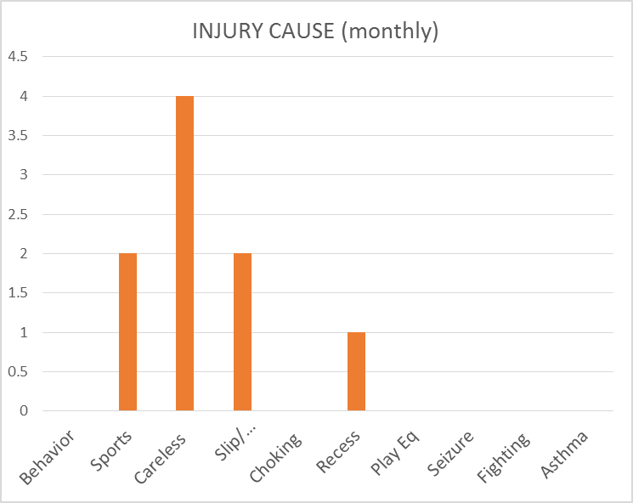
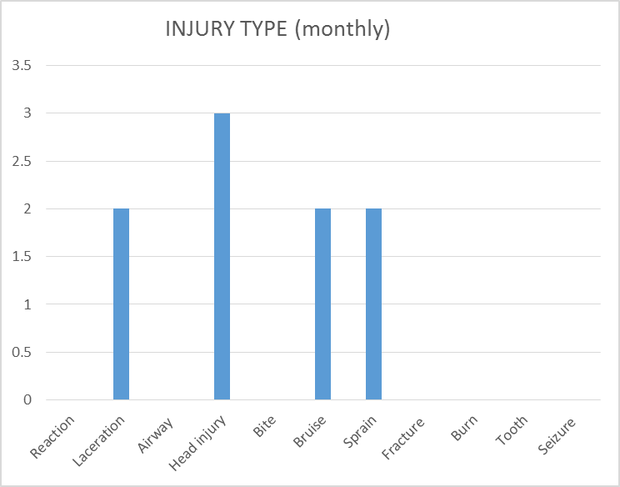
SAFETY
CHARTS

Slide 8
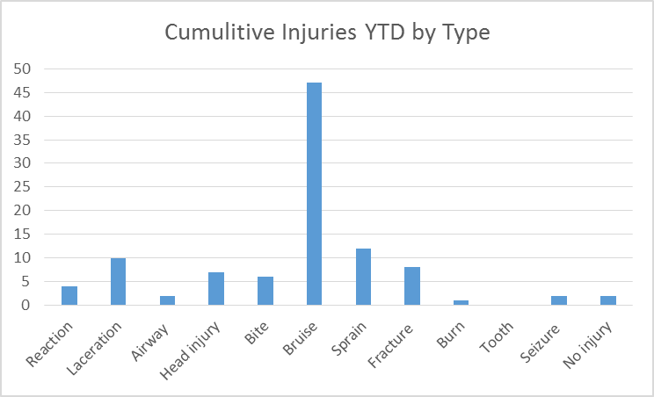
Year End Safety Summary
Yearly Summary to Date
Reported injuries for the year were 101.
There were 38 associated with student behavior.
19 injuries were associated with sport activities.
16 were related to careless or inattentive behaviors.
12 slip/trip/falls related injuries.
The balance were low single digit occurrences related to multiple causes (recess, play eq., seizure, asthma, etc.).
Who Was Injured?
Students – 48, Staff – 53, Visitors – 1
Most of the staff injuries were the result of
student behavioral issues (38) and were minor injuries. This also accounts for most of the “bruise” injuries. The bruise category also includes light abrasions and tender skin due to incidents.
Injuries by School
WPS-44 (majority of behavioral related issues)
WMS-11
WHS -27 (majority of sports related injuries)
WIS-14
Yale-6

